Slide 1
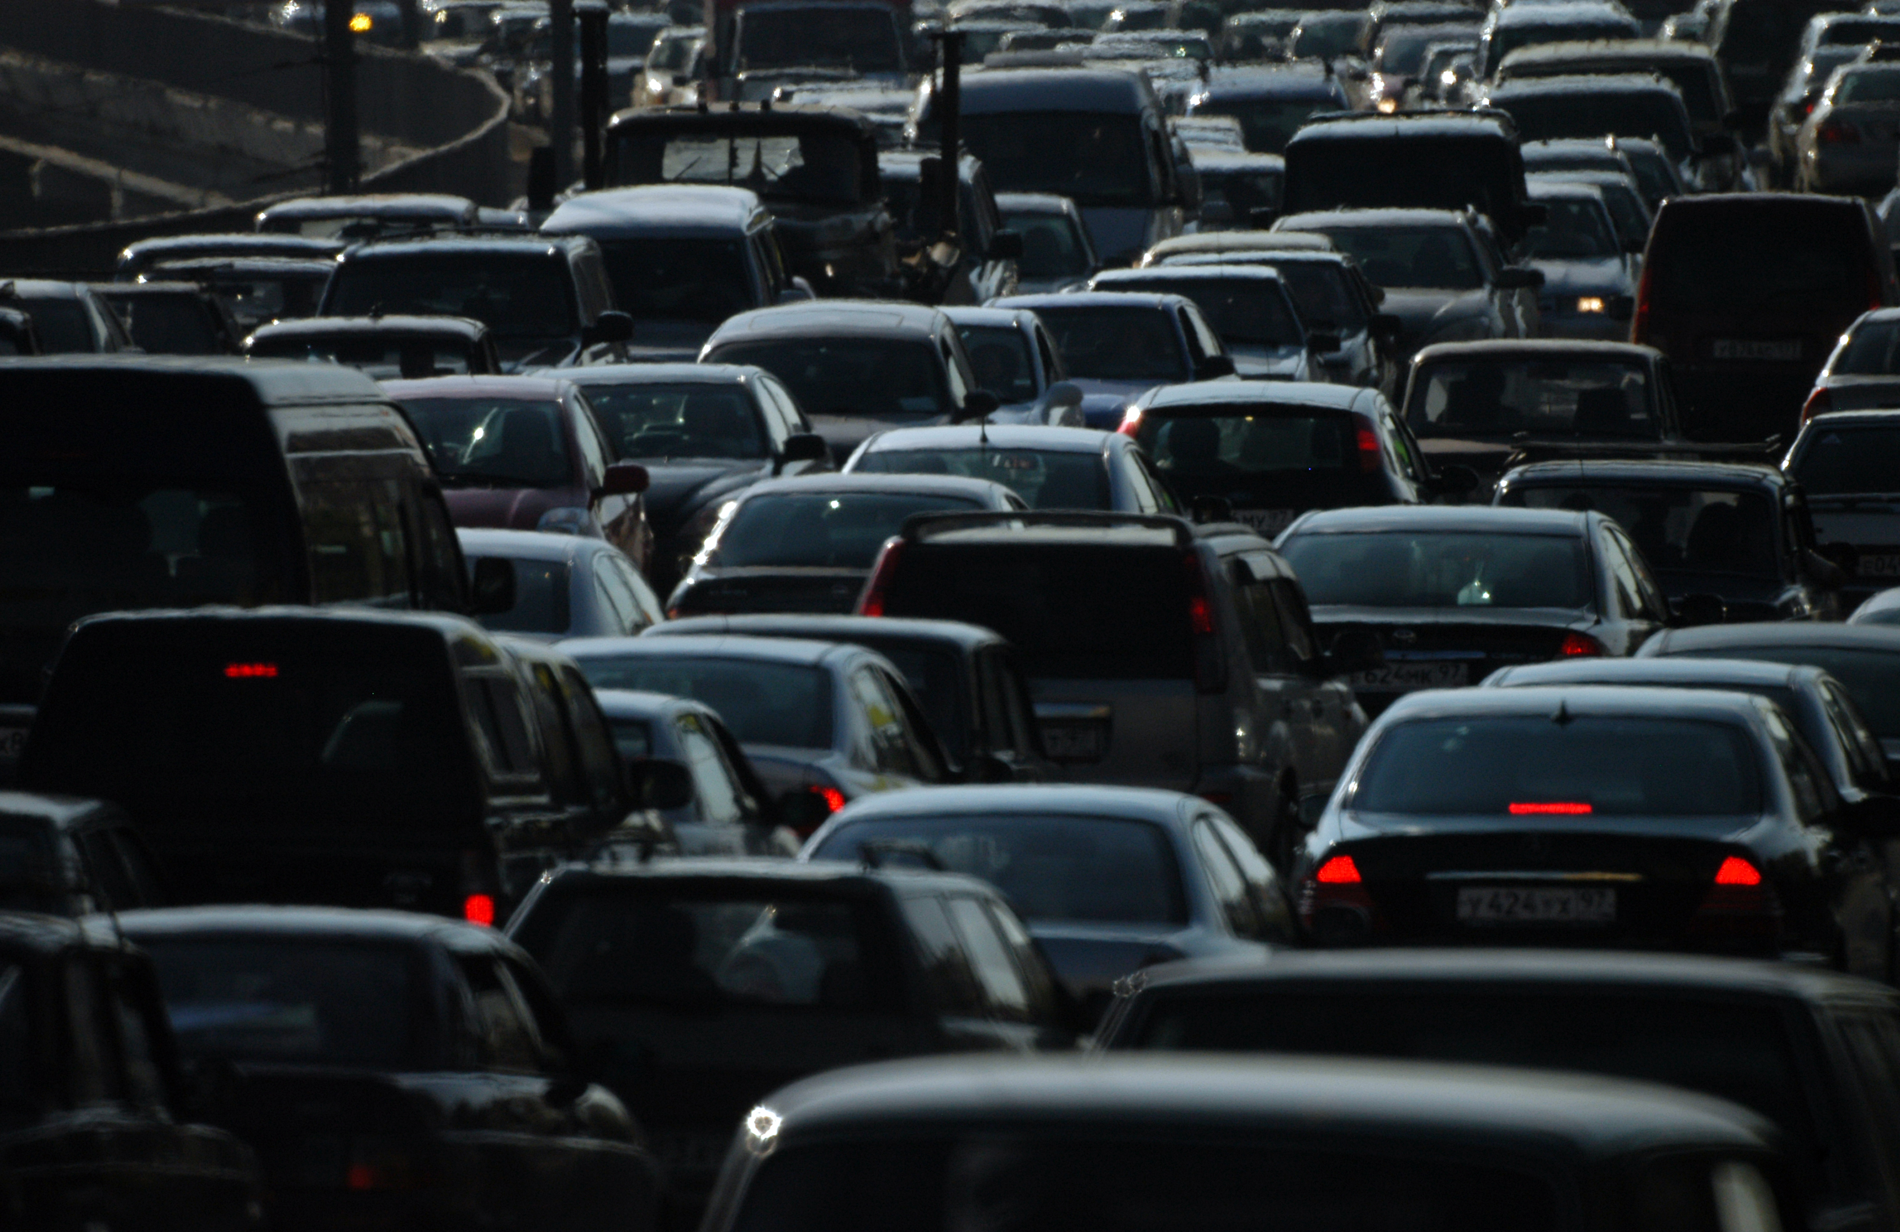
1,075 Chicagoans died in Traffic Accidents in 2022

Slide 2
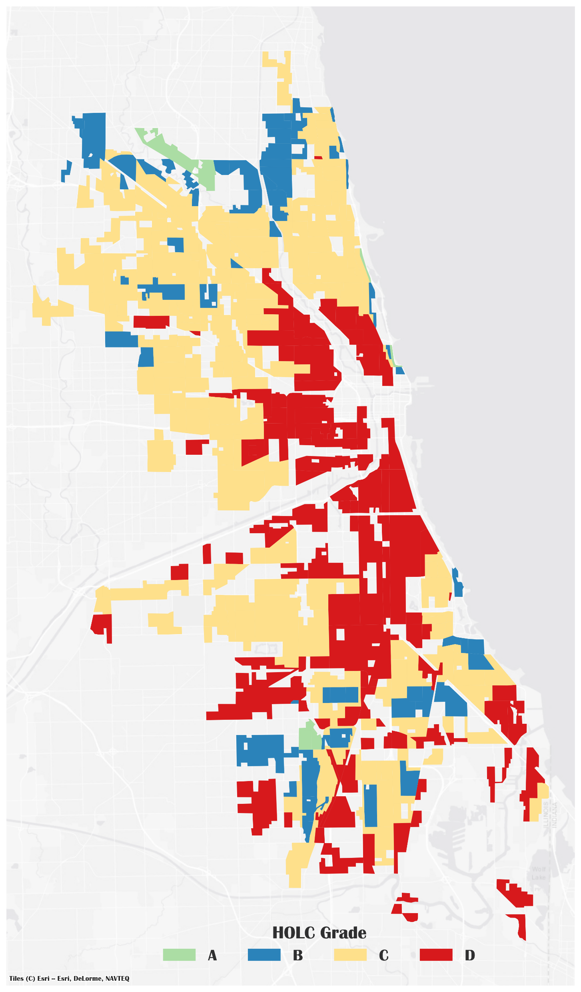

Slide 3
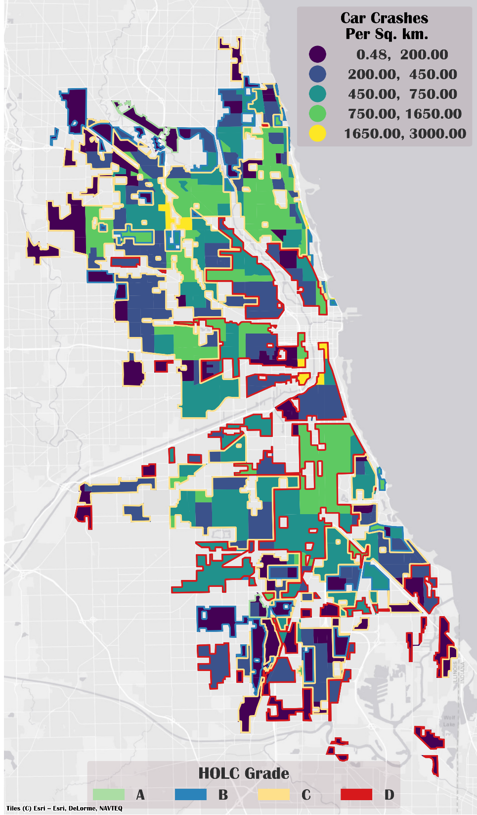
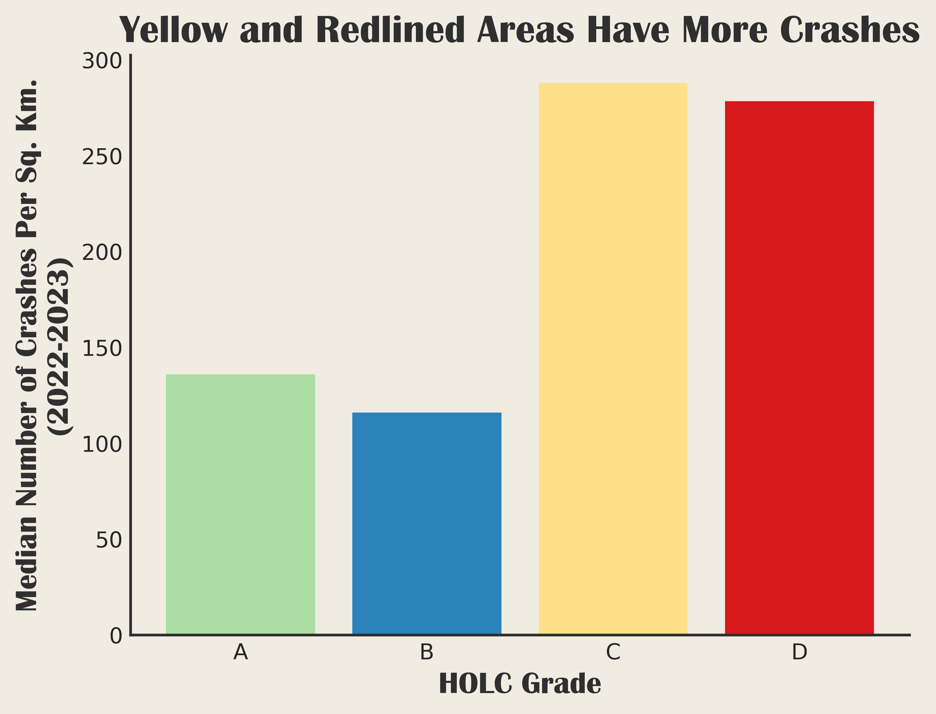

Slide 4
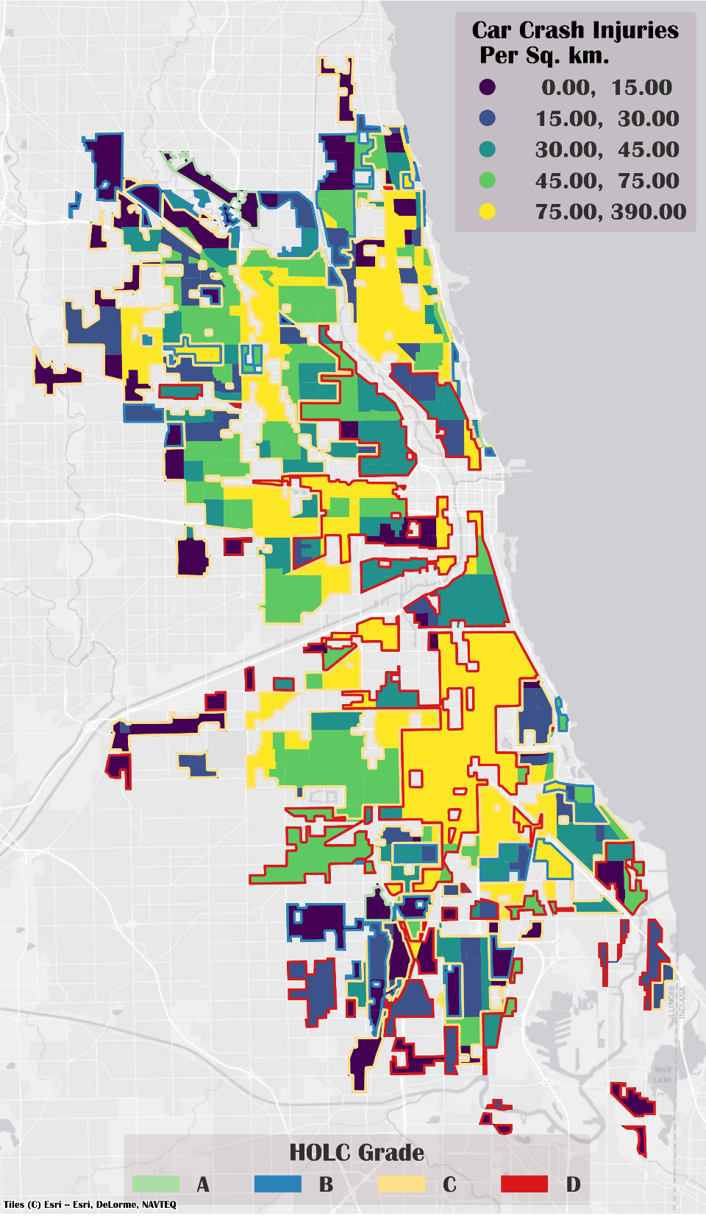
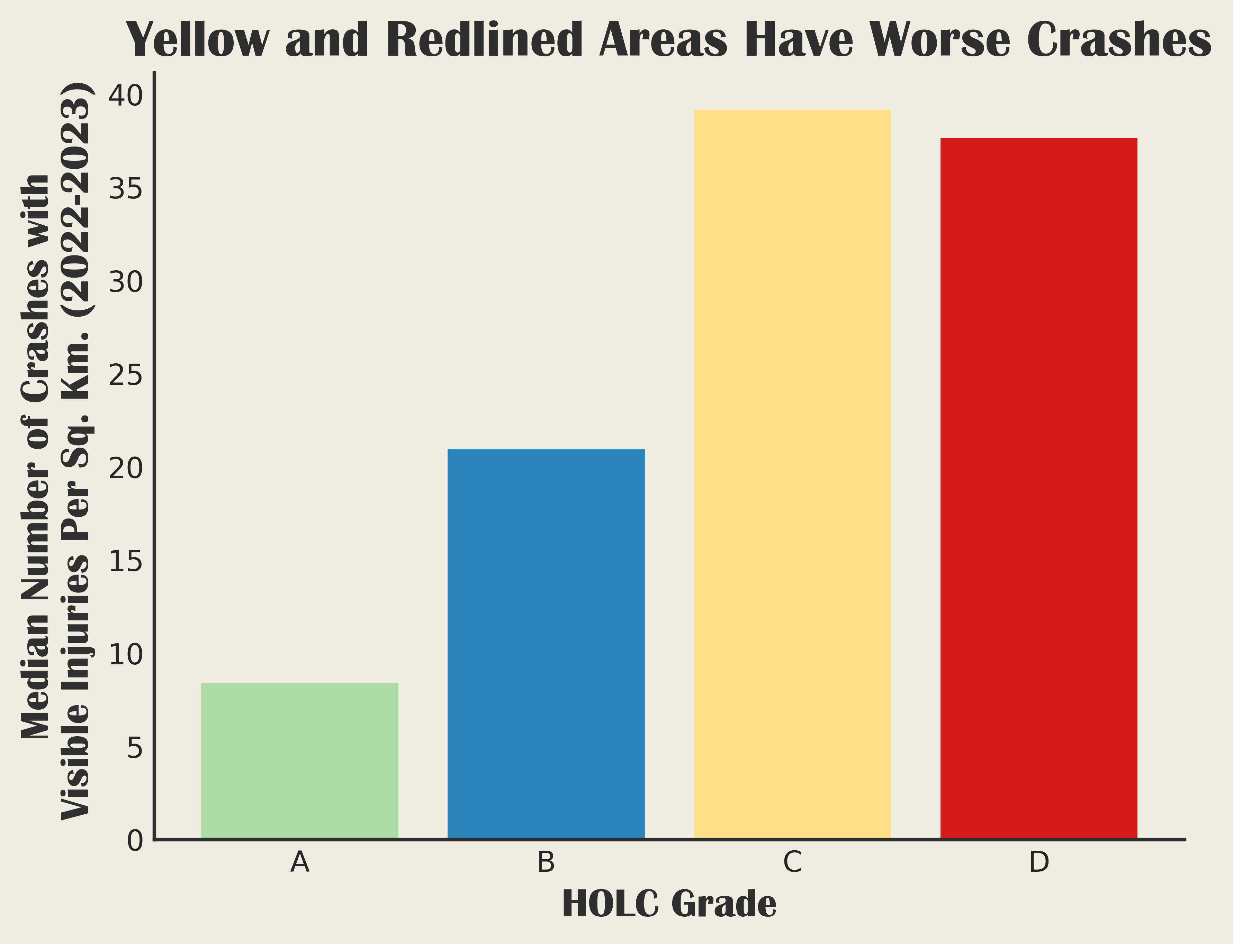

Slide 5

2024
Health Outcomes
1930s
Redlining

Slide 6
How do we think about health?
And how does that explain the connection between redlining and now?

Slide 7
Social and Community Norms
Health Care Access and Quality
Economic Status
Social
Determinants Of Health
Education Access and Level
Physical Environment

Slide 8
a short theory of accident severity
(in which we oversimplify greatly, but with purpose!)

Slide 9

Slow
Car vs Car Accident

Slide 10

Slow
Car vs Car Accident
Less Risk of Injury

Slide 11

Fast
Car vs Pedestrian Accident

Slide 12

Fast
Car vs Pedestrian Accident
More Risk of Injury

Slide 13
Keep Pedestrians and Cars Separate
Keep Speeds Slow

Slide 14
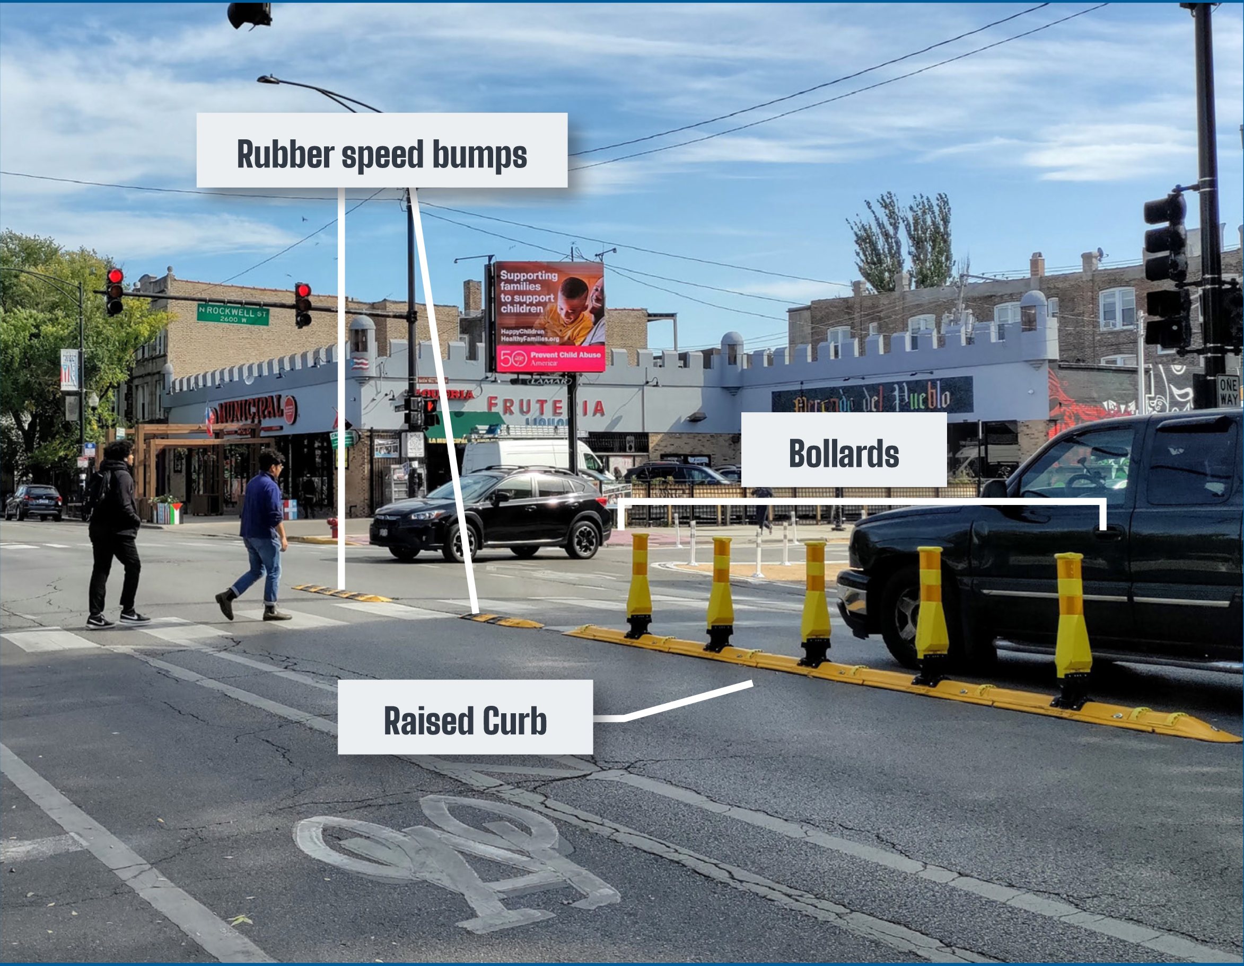
Street Design
Adapted from Chicago Department of Transportation, “Left Turn Traffic Calming”

Slide 15
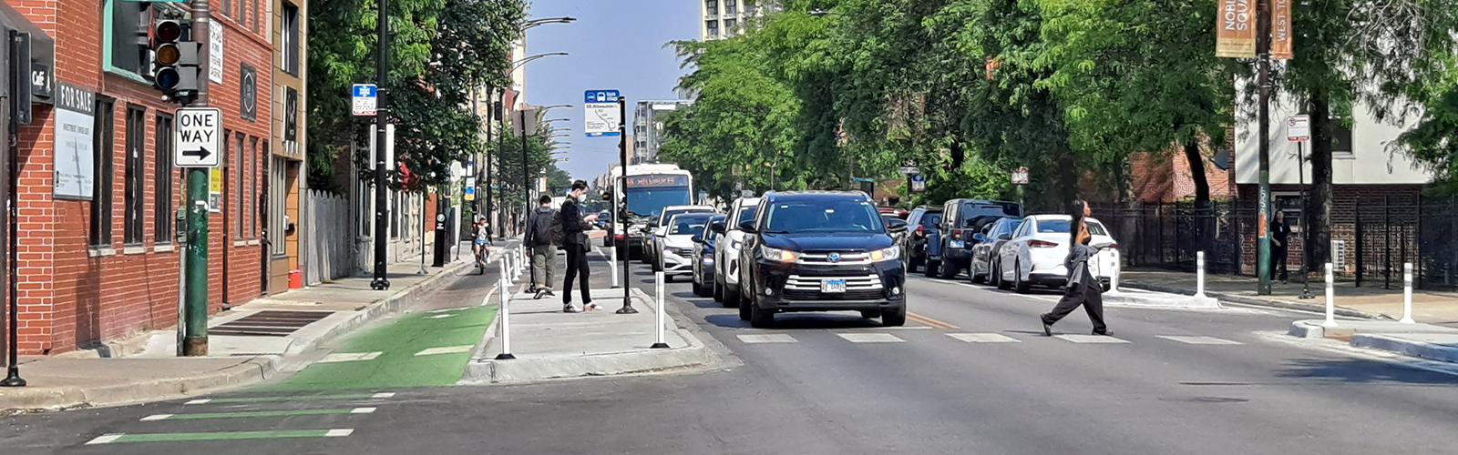
Street Design
Bus Boarding Island
Pedestrian Bump Outs
Protected Bike Lane
Image from Chicago Department of Transportation,
“Bus Boarding Islands”

Slide 16
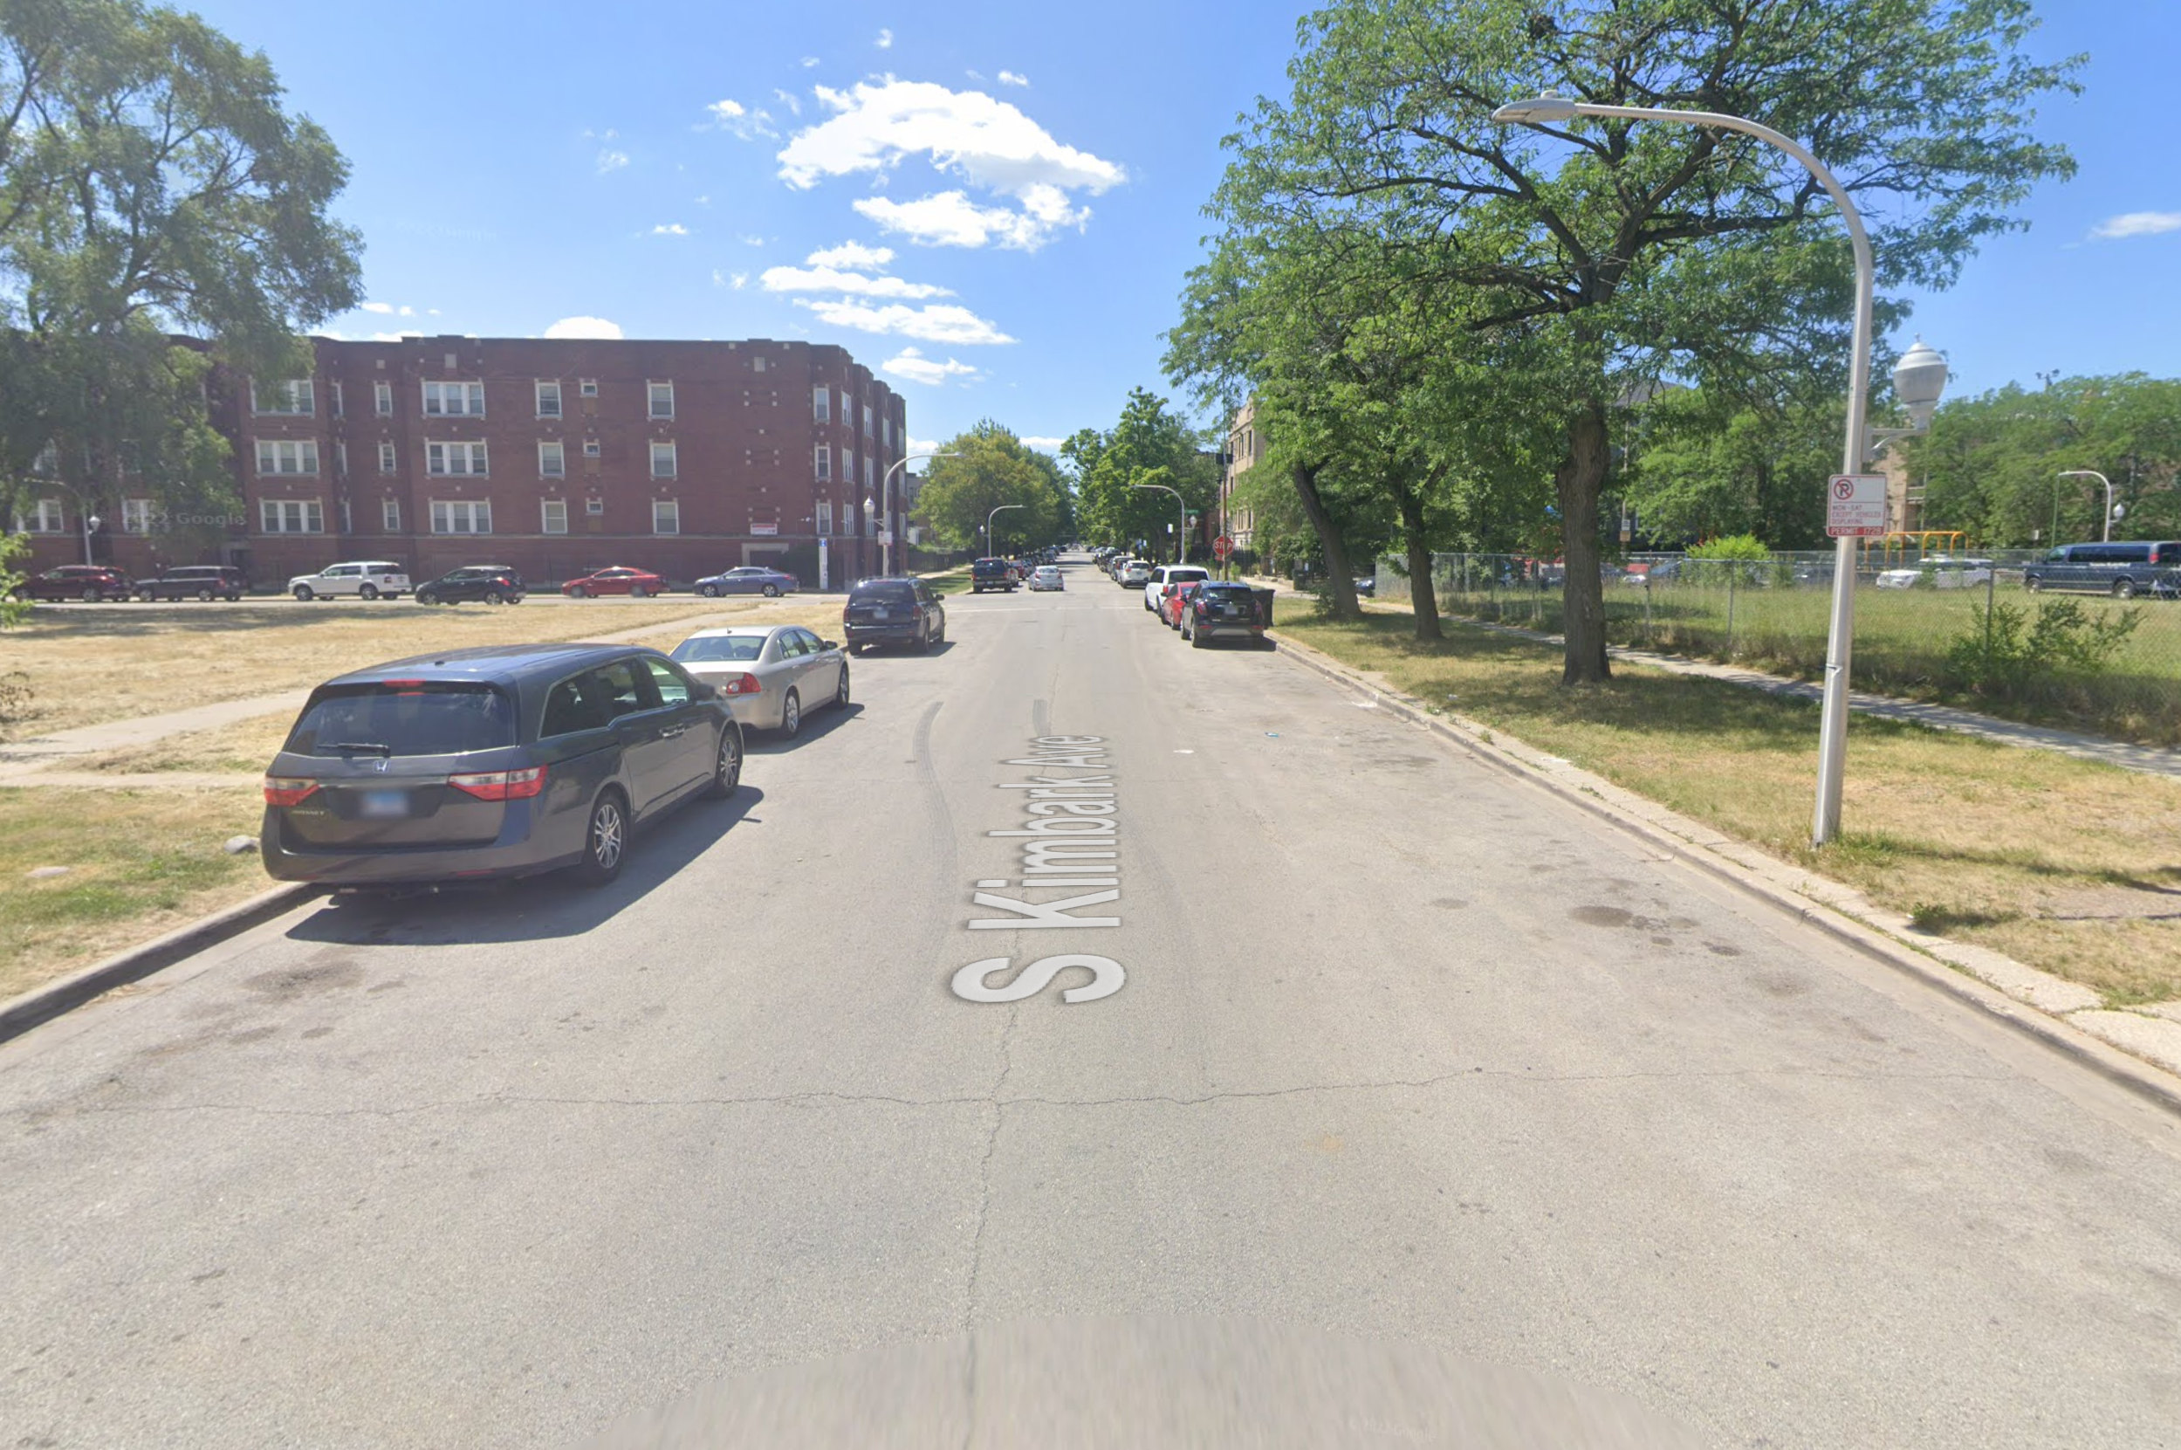
Street Design
(Photo Credits to Google Streetview)

Slide 18
Because investment can make us safer
Health Outcomes
In 2024
1930s
Redlining

Slide 19
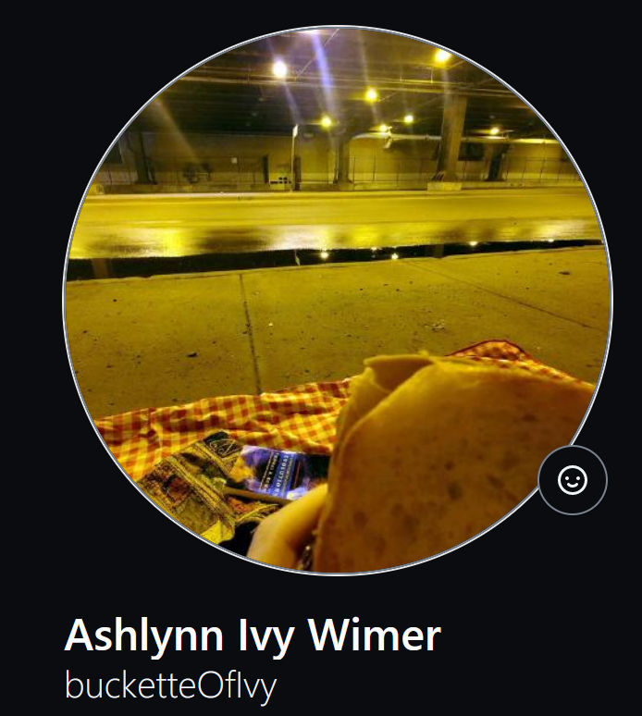
Thank you for listening!
Feel free to ambush me to talk about the intersection between health, GIS, and machine learning.
(or silly slide shows. those are cool too)
buckette.gay ‍

